Slide 1



OFFICE SUPPLY SALES REPORT
FOR CAPSTONE STATIONERIES
SEPT 2013 – DEC 2014
Presented by: EMMANUEL ELUBA
15 FEB 2025

Slide 2
1
EXECUTIVE SUMMARY
KEY FINDINGS / SOLUTIONS
2

Slide 3
RECOMMENDATIONS
3
CONCLUSION
4

Slide 4



EXECUTIVE SUMMARY
This Office Supply Sales Data Analysis Report provides a detailed review of sales performance across key states, segments and of products.
The primary objective is to evaluate revenue trends, identify top performing products, and uncover areas for improvement. Key findings reveal growth opportunities, seasonal trends and insights into sales/revenue patterns.

Slide 5
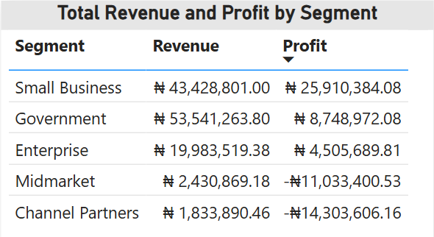

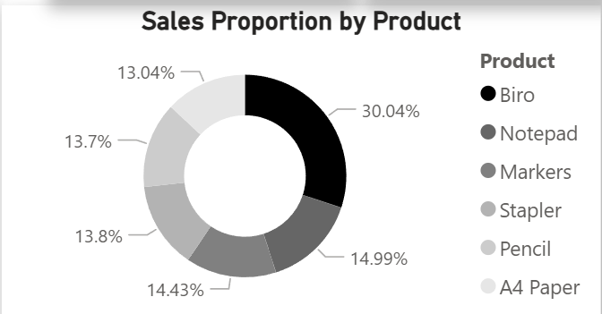
KEY FINDINGS
The analysis revealed the following;
The Biro product accounted for more than 30% of total sales, making it the top selling product.
Small Businesses, and Government make up the most profitable segments with N25.9m and N8.7m respectively

Slide 6
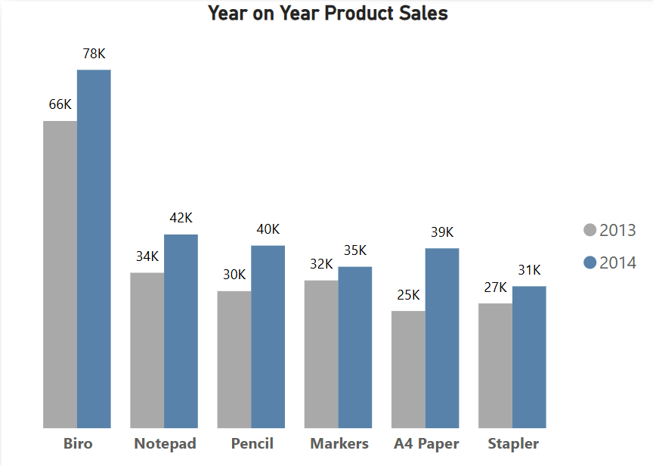
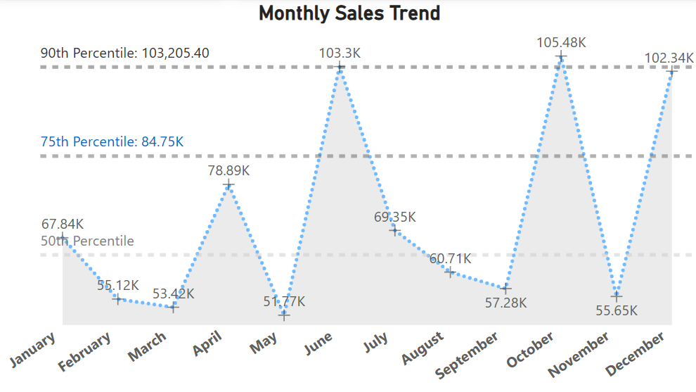
INSIGHTS
Sales Peaked in June(103k), October (105k) and December (102k) which were above the 90th percentile. The trends suggest a spike in sales every 3-4 months indicating possible periodic demand surges.
The Year-on-Year growth trend for Q4 of both years in review revealed an increase in product sales with Q4 2014 being particularly strong indicating a possible end of year demand or sales due to promotions.

Slide 7
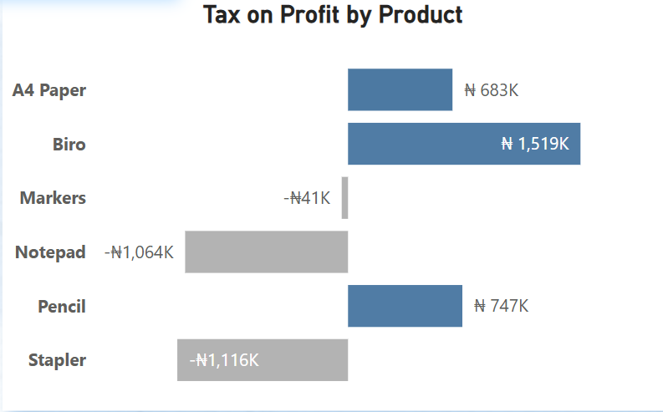
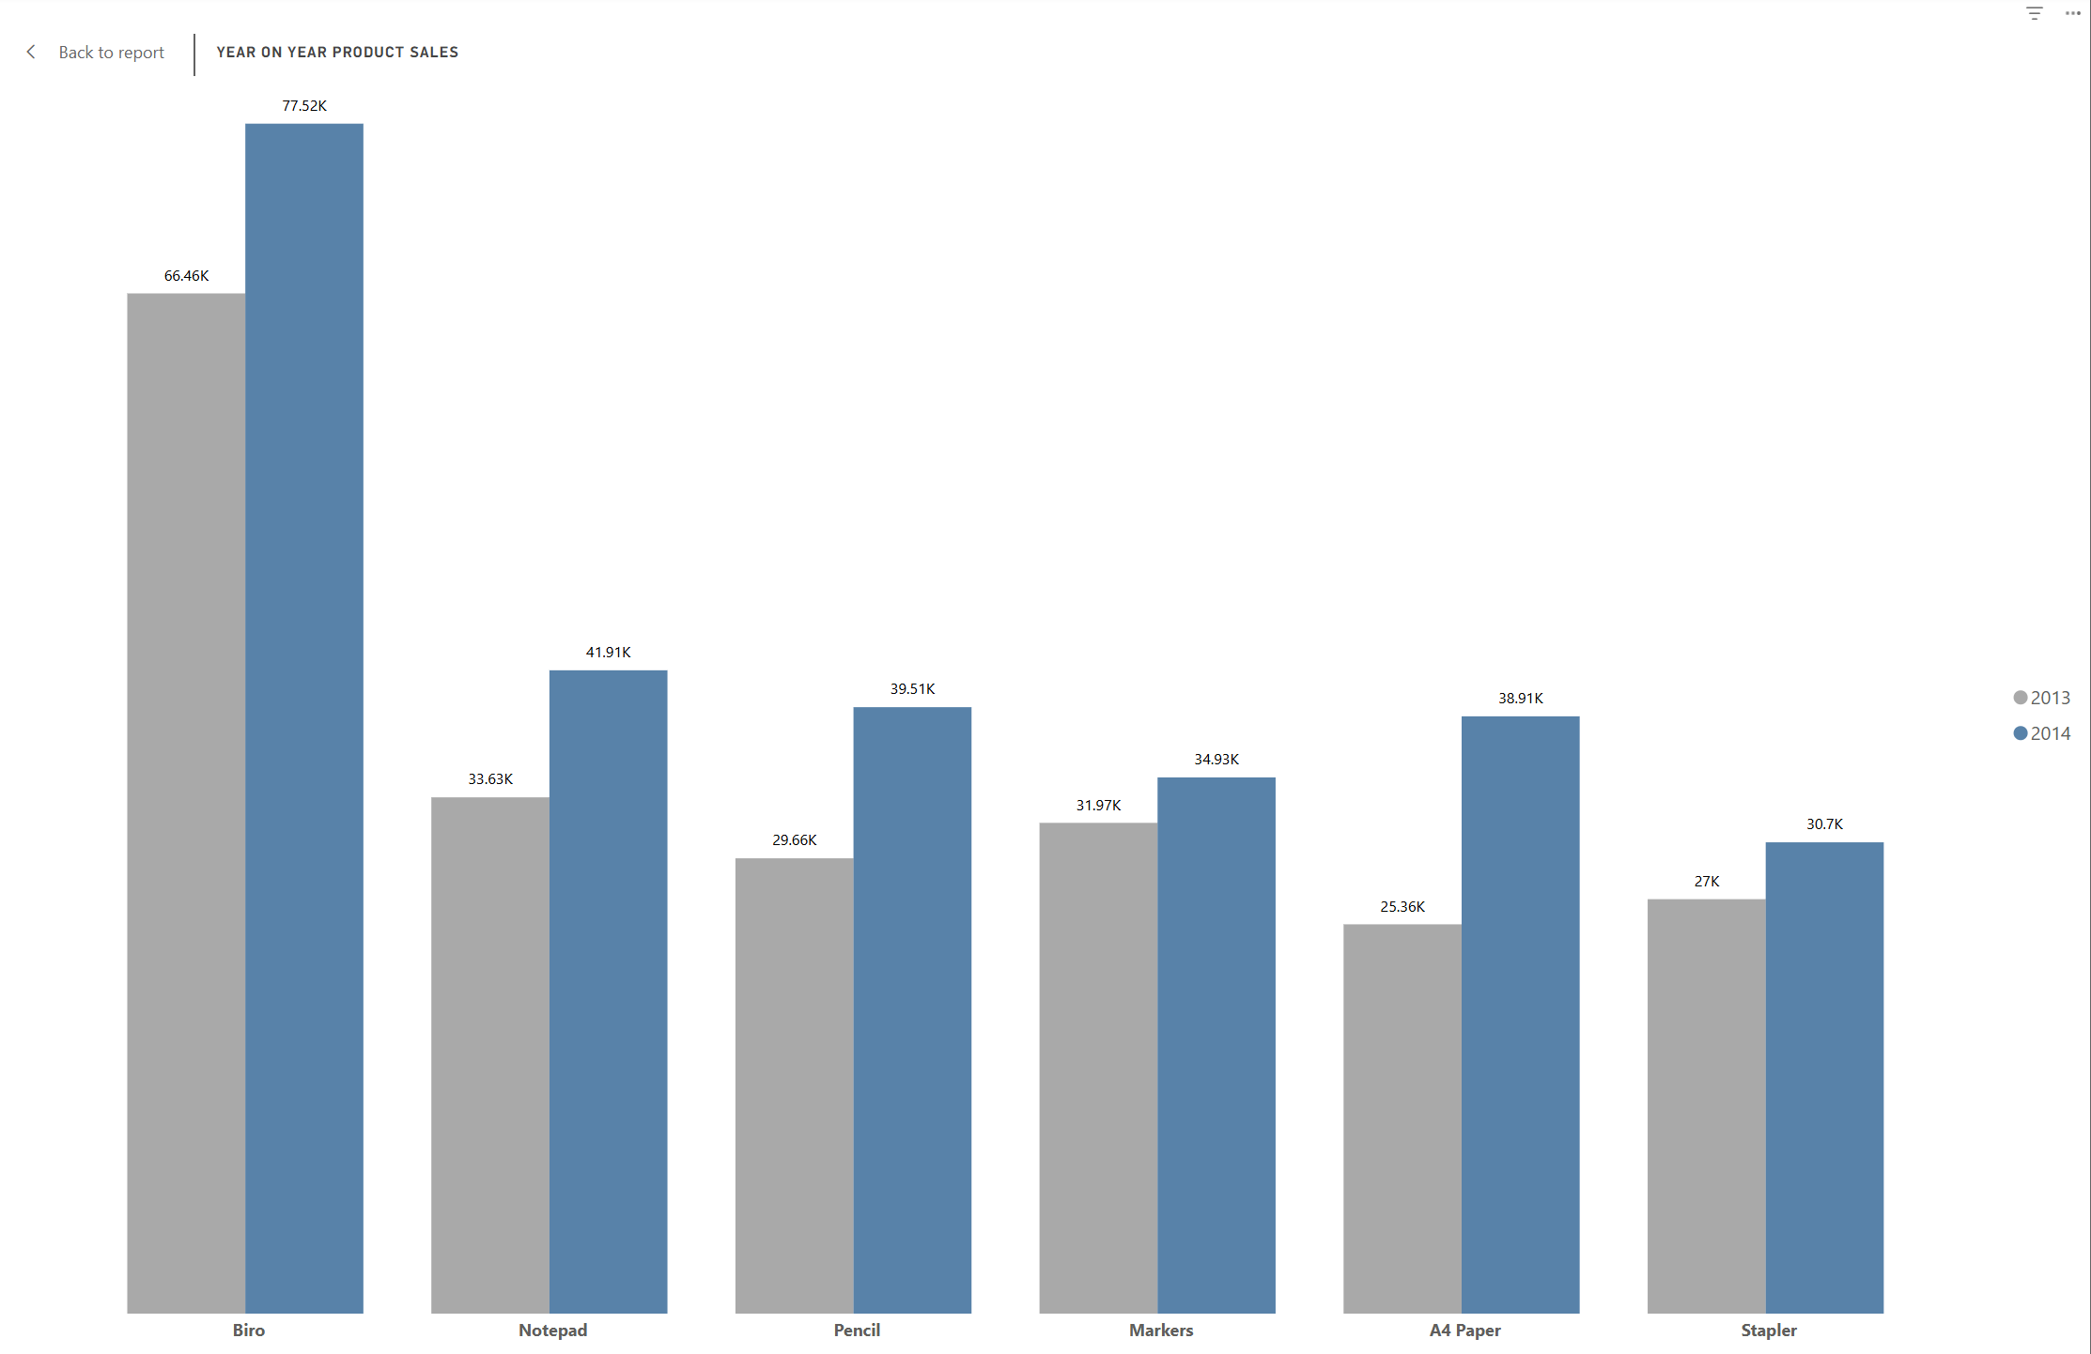
INSIGHTS (ctd)
For Q4 2013 vs 2014, we see that all products showed positive growth (49.6k ,23.2% growth) with no declines. A4 Paper had the most substantial growth in both absolute and percentage terms (13.6k, 53.8%). There is a robust year on year improvement with A4 paper and pencils driving the most significant gains.
The Biro has the highest Tax on profit at N1.5m, while Notepads and staplers have the largest losses and hence negative tax amounts.
Notes:
Total sales for all products combined in Q4 2013 = 213.8k, vs 2014 263.4k. 23.2% growth.

Slide 8
RECOMMENDATIONS:
Based on the findings, the following strategies are recommended
1. Leverage Peak Sales Months (June, October, December) and introduce targeted promotions and stock replenishment strategies leading up to these months to maximize sales (could consider a quarterly subscription model)
3. Biro (best selling product) and A4 papers (best profit margin) should remain the flagship products with continuous availability and minimal price fluctuations, while Staplers should be considered for discontinuation or repositioning as premium products.
2. Boost underperforming states and segments. Ondo has the least revenue but is highly profitable so increased market penetration there with minimal cost could boost revenue and profit.
Channel partners should be incentivized to increase their contribution possibly through better commissions or bulk discounts.
4. Oyo and Lagos generate high revenue but are not the most profitable. Reduce unnecessary discounts or operational costs in these states and evaluate whether discounts are reducing profits disproportionately and adjust accordingly.

Slide 9

CONCLUSION
This Sales Data Analysis Report provides critical insights into products, revenue trends and regional performance. By implementing the recommendations, Capstone Stationeries can enhance sales strategies, improve customer engagement, and drive sustained revenue growth.

